Slide 1
Notes:
Good morning staff and students. Today, we are here to talk about an exciting new group beginning in our school. It’s called “Era for Change”.

Slide 2
Detention for Detention 2015
Notes:
Today, we would like to answer these questions for you about ERA for Change…
What is ERA for Change?

Slide 3
Did you know….
The Government's latest statistics, dated 31 March 2015, reveal that:
124 children are held in immigration detention facilities within Australia
103 children are held in detention on Nauru
1,282 children are detained in the community under residence determinations, a system referred to as community detention
2,760 children are living in the community on bridging visas which mean their parents generally have no work rights and very limited access to any Government support (www.chilout.org)

Slide 4
From the Asylum Seeker Resource Centre…

Slide 5
So what can we do?
Notes:
Today, we would like to answer these questions for you about ERA for Change…
What is ERA for Change?

Slide 6
Detention for Detention 2015
Notes:
Today, we would like to answer these questions for you about ERA for Change…
What is ERA for Change?

Slide 7
Detention for Detention 2013 & 2014: Our voice was certainly heard…
Notes:
In 2013 and 2014, the biggest ERA for Change event each year was “Detention for Detention”. It was a simple yet powerful stand against the concept of children being kept indefinitely in detention as they attempted to seek asylum in our country. These are some photos from last year’s event…

Slide 8
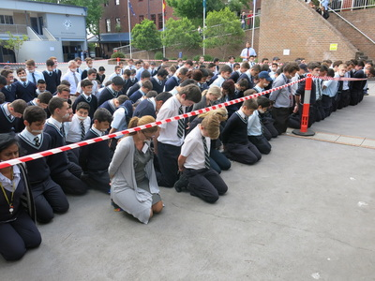
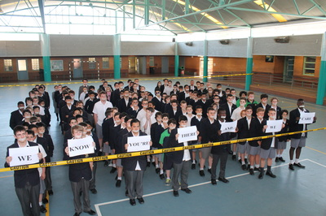

Slide 9
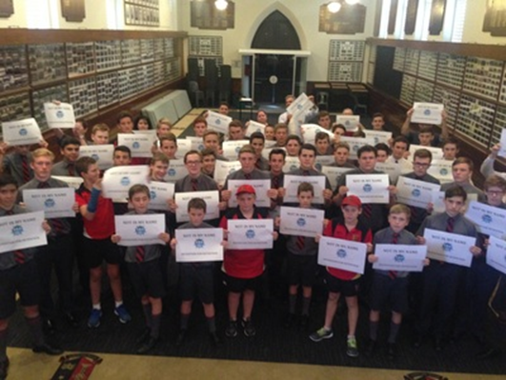

Slide 10
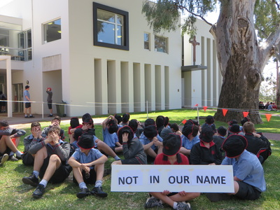

Slide 11
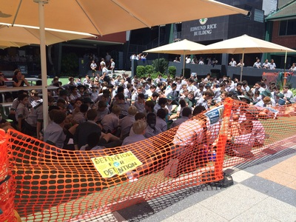

Slide 12
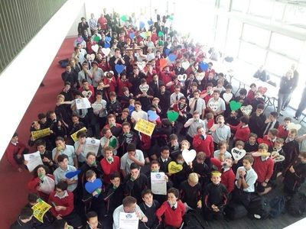

Slide 15
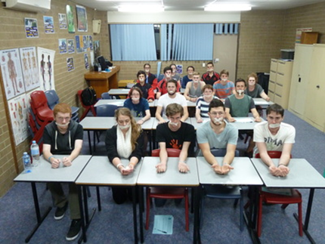

Slide 18
In fact, numbers of children in detention have significantly reduced in recent times, but…
Notes:
Today, we would like to answer these questions for you about ERA for Change…
What is ERA for Change?

Slide 19
We believe that…
Notes:
Today, we would like to answer these questions for you about ERA for Change…
What is ERA for Change?

Slide 20
ONE CHILD IN DETENTION IS ONE TOO MANY.
Notes:
Today, we would like to answer these questions for you about ERA for Change…
What is ERA for Change?

